Slide 1

Dual and Ghouls: Challenges and Opportunities for
Dual Enrollment Student Success
Notes:
MEK

Slide 2
Welcome!
Please enjoy the music and introduce yourselves to one another 😊
Notes:
MEK and KV

Slide 3
Agenda
Welcome
Dual Enrollment at Cuesta College
Student Evaluations Details and Examples
Dual Enrollment Instructor Panel
Group Discussion: Supporting Student Success
Next Steps and Future Opportunities
Notes:
MEK
Before we get started, please raise your hand if you are a:
High school teacher
Cuesta faculty
Administrator

Slide 4
Dual Enrollment at Cuesta College
Notes:
KV

Slide 5
Cuesta College Dual Enrollment Options
Enrichment
CCAP (College and Careers Access Pathways)
Allows currently high school students to earn college credits “outside of the high school day”
School principal or high school administrator must approve that the student would benefit from "advanced scholastic" or "vocational" college coursework.
Students can take any class in the online Class Finder schedule.
Individual students, with approval from their guardian(s) and high school administrator register under the Enrichment program.
Enrollment fees are waived.
Allows high school students to earn college credit for a course taken “during the high school day."
Students earn grades for both their high school and Cuesta transcripts.
Courses are set up as a collaboration between the high school and Cuesta so that all students in the class have the option to earn college credit.
Available course offerings depend on the willingness and availability of high school districts and Cuesta faculty.
There is no cost to students.
For more information, visit the Cuesta Dual Enrollment Website
Notes:
MEK
$46 per unit enrollment fees are waived (Enrichment) - this does not include student fees or any materials costs for specific courses (e.g., textbooks)
CCAP - This offering began in Fall 2014

Slide 6
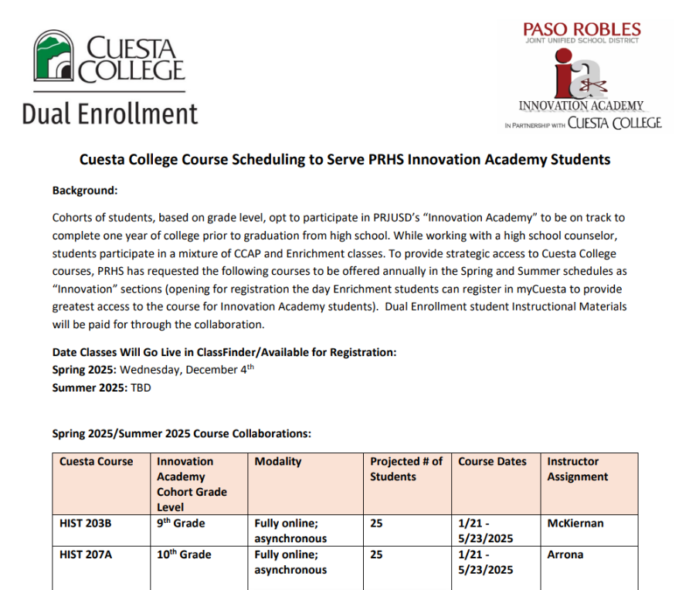
Enrichment Opportunities:
Innovation Section Development
Dual Enrollment Office Collaborates with High Schools to Request Summer Innovation Sections
  Way to articulate and capture request for demand from high school students
Courses Open in Class Finder the day Enrichment Students Can Register
Notes:
KV

Slide 7
CCAP Program Overview
Students participate in closed Cuesta College classes during their high school day in their high school period
  Simultaneously represents high school and college credit
  Student receives transcript for both
Completely Free
  No campus-based or Instructional Materials fees
Courses are a part of a particular pathway:
  Career and Technical Education
  Preparation for Transfer
  College and Career Readiness
Notes:
KV

Slide 8

Notes:
KV
Shandon
Templeton
Paso Robles
Atascadero
Coast Union
Grizzly
Morro Bay
Juvenile Hall
Mission Prep
SLO Classical Academy
Pacific Beach
SLO
AG
Nipomo
Central Coast New Tech
(Paloma Creek prospect)

Slide 9
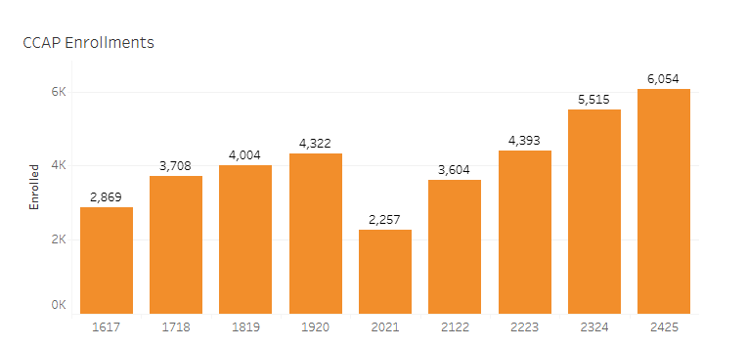
2024-2025 Academic Year Overview
393 Cuesta College sections
  Roughly 15% in Cuesta Led Model
67 Unique Courses
  CTE; Transfer Prep; College and Career Readiness
4,202 Unduplicated students
93 High School Teachers
26 Cuesta Faculty Utilizing Load for CCAP
Notes:
KV

Slide 10

CCAP Promotional Video
Notes:
KV

Slide 11
CCAP Models
HS Teacher Led (85%)
Cuesta Led (15%)
High School Teacher meets Minimum Qualifications and is the Instructor of Record
  Submit Course Syllabus
  Submit Census Roster
  Submit Grades
  CCAP Enrollment Support
Instruction paid for by HS District
District and High School Teacher Stipend Model
Model began in Fall 2018
High School Teacher does not meet Minimum Qualifications
Instruction is delivered fully online
  HS Teacher is added as 'Teacher' in Canvas Shell
  Course Scheduled as 16-week, 18-week, or year-round (August to end of Spring term)
Instruction paid for by Community College District
Notes:
KV

Slide 12
High School Teacher Led CCAP:
Student Evaluations

Slide 13
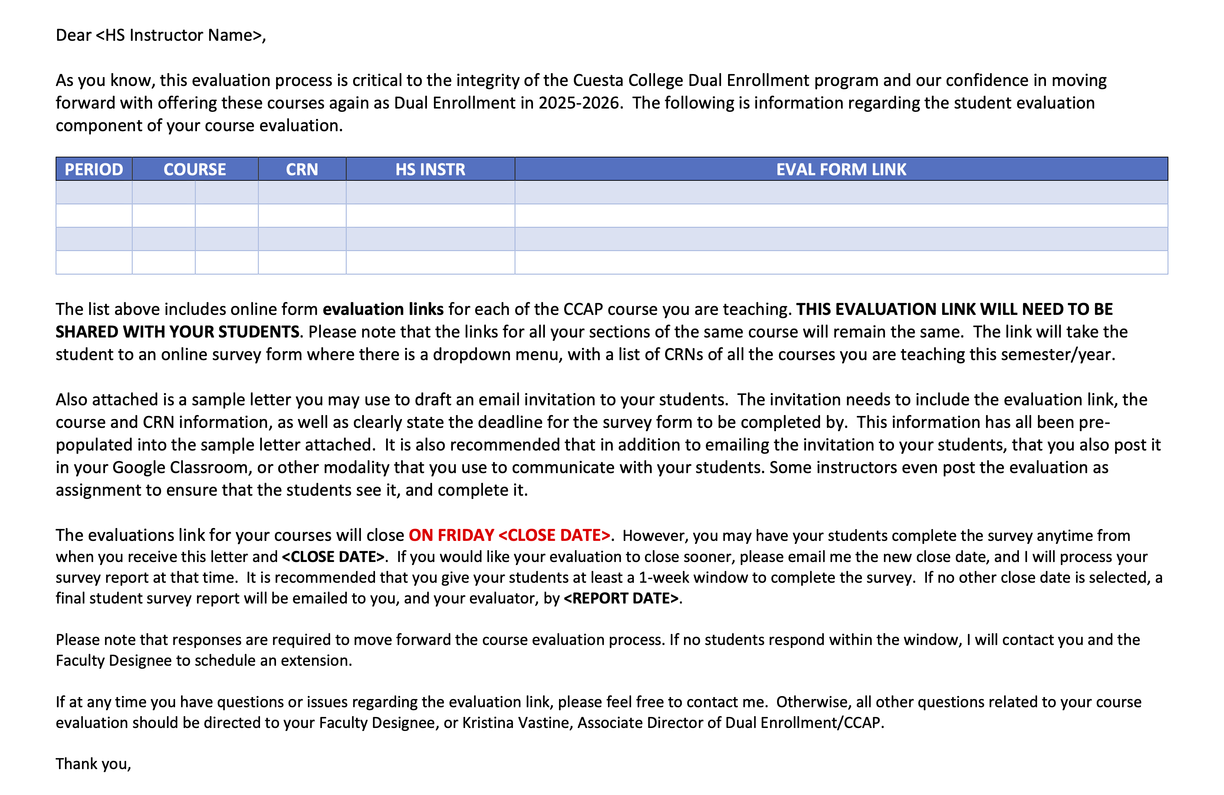

Slide 14
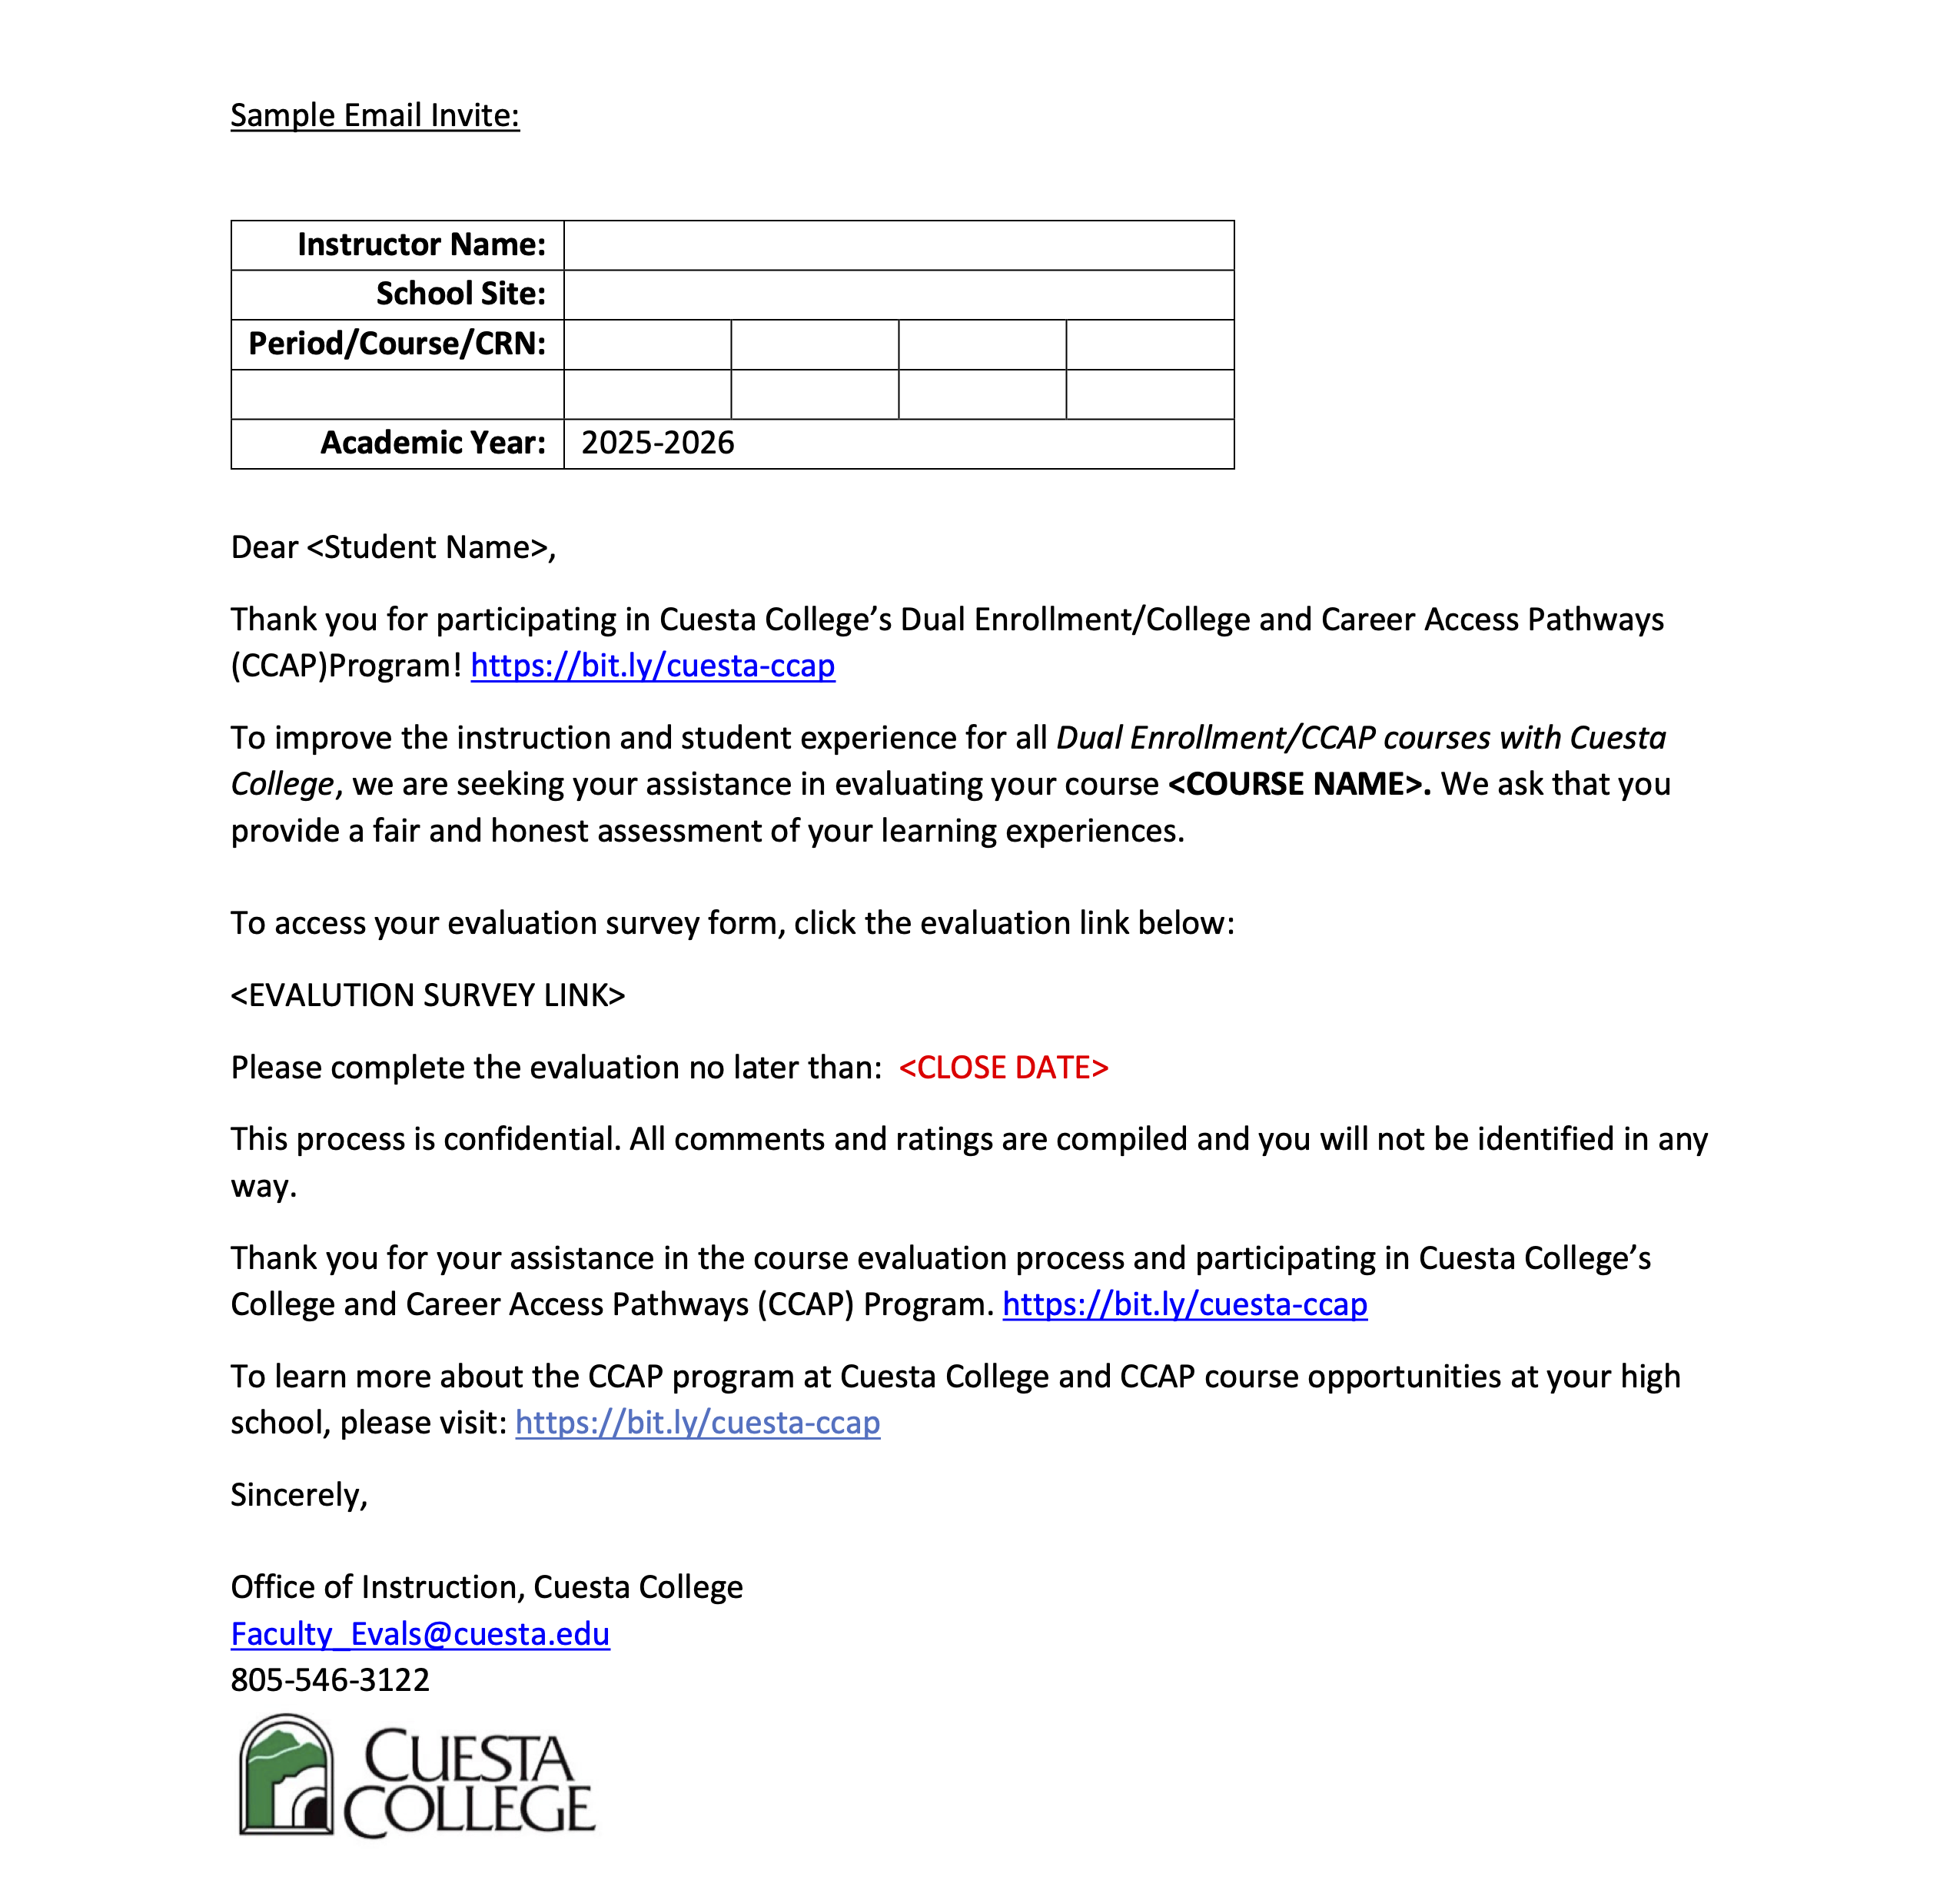
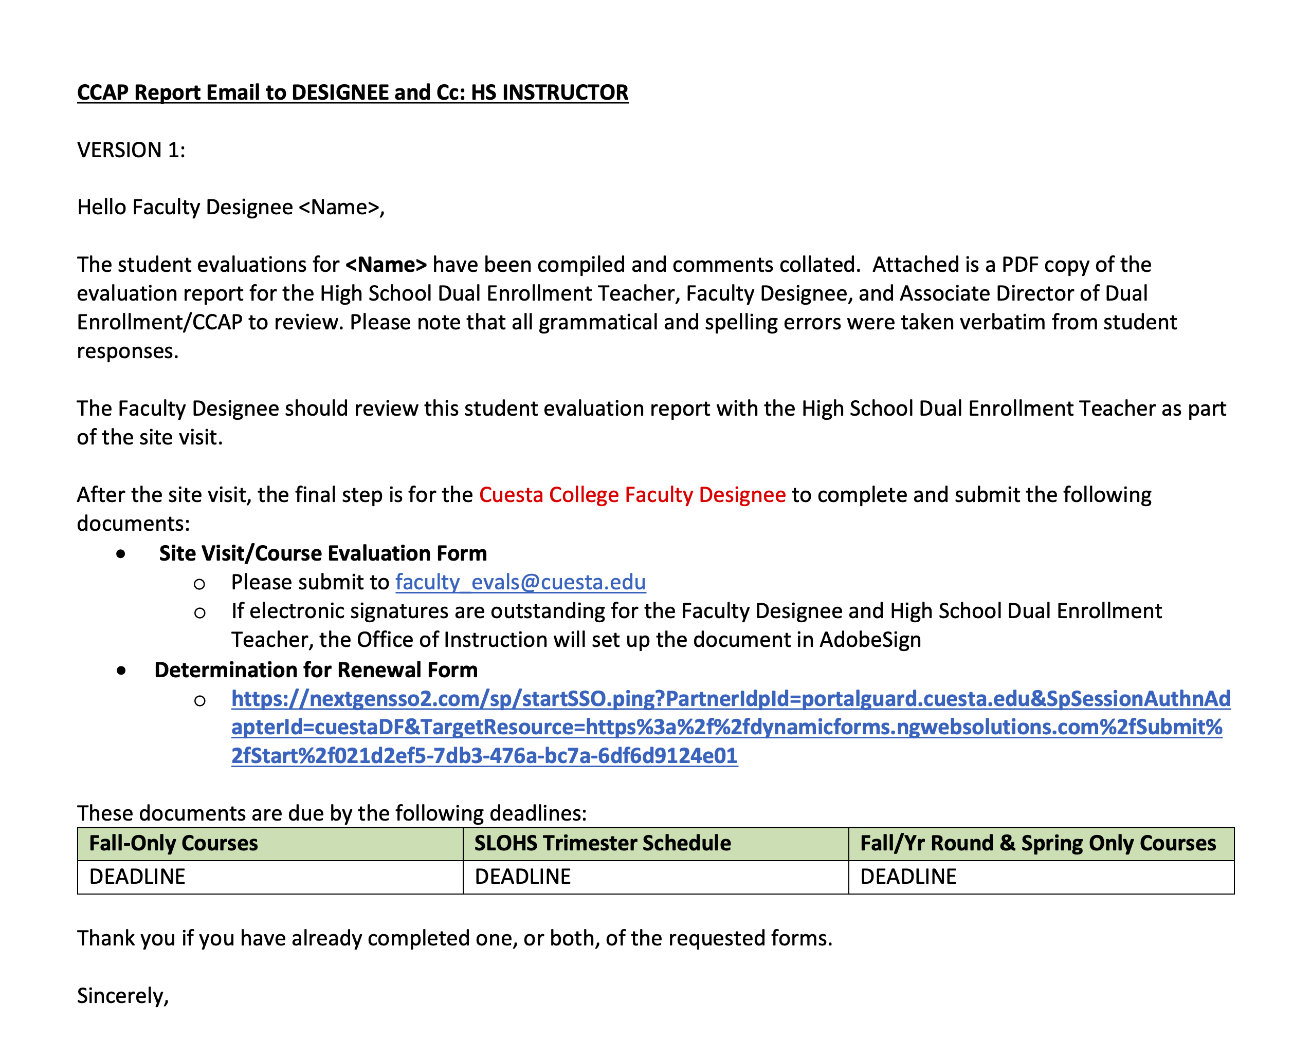

Slide 15
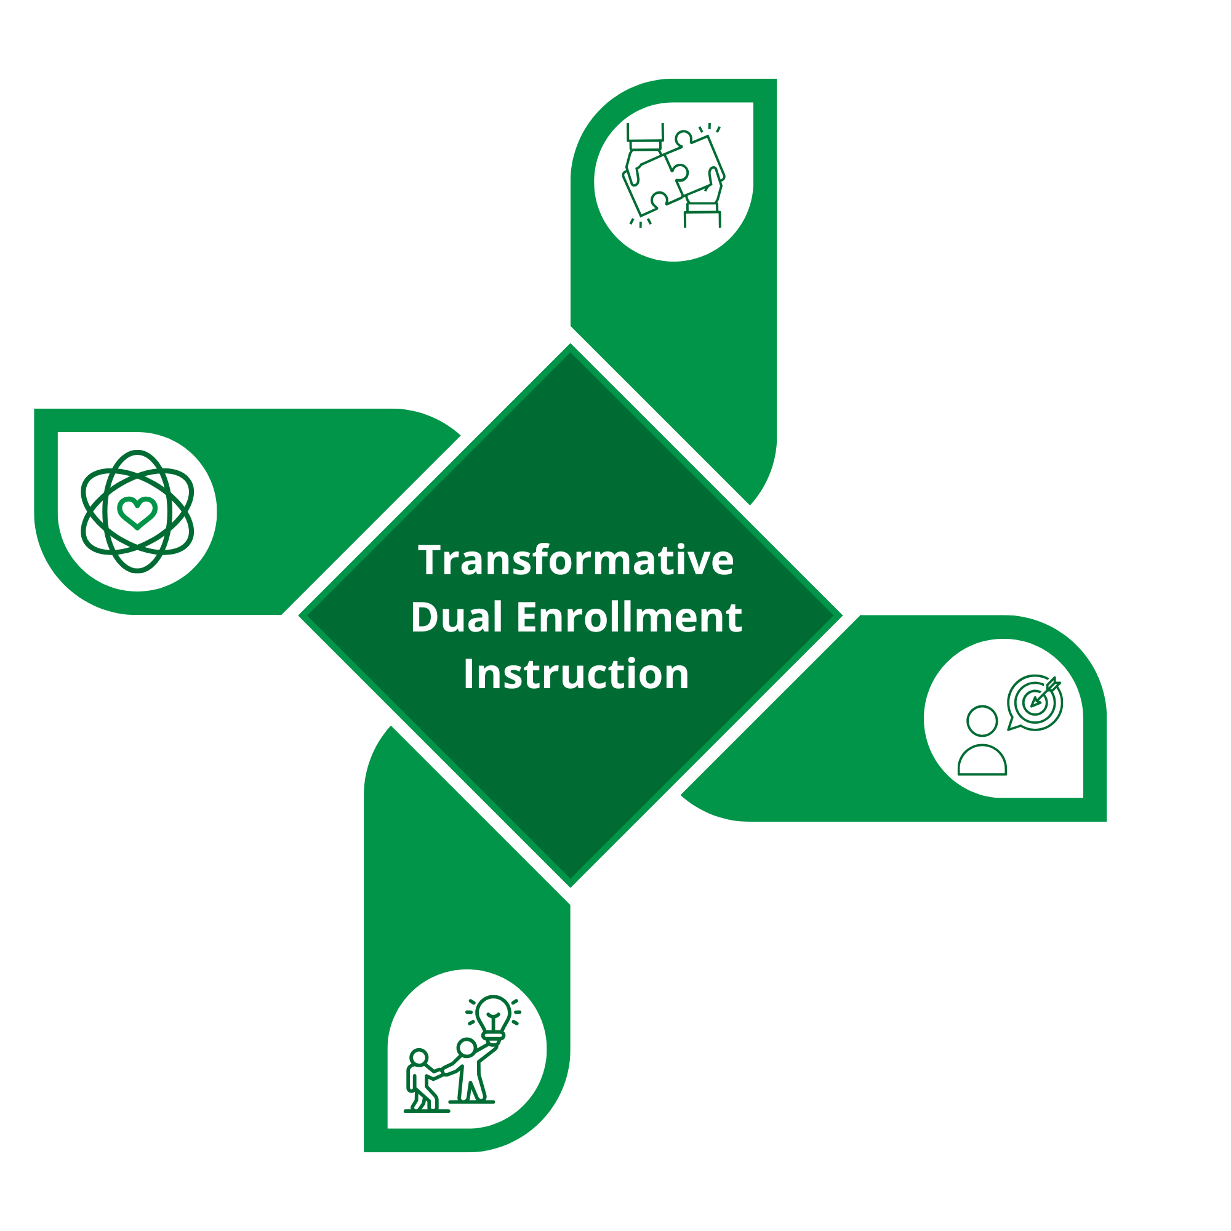
Equity-Driven Strategies for Success
Recognize and Build on Student Drive
Connect Students to Supportive Adults and Peers
Make Curriculum Relevant and Useful
Help Students See the Bigger Picture
Notes:
MEK
Transformative Dual Enrollmlent Instruction is powered by Student Drive and Builds on Connection to Provide a Relevant and Useful Education that Helps Students See Themselves in the Bigger Picture
Instructors who recognize students’ motivations help sustain their purpose and progress.
Supportive relationships with peers, family, and educators help students feel seen, connected, and confident.
Culturally relevant coursework deepens engagement by linking learning to students’ lives and aspirations.
Clear guidance helps students envision their futures, make informed choices, and navigate educational institutions.

Slide 16
Instructor Panel
Notes:
How do you see students balancing the demands of high school and college courses at the same time?
What are the most common points of confusion that dual enrollment students face?
How do you explain college-level expectations to students?
How do you encourage students to take ownership of their learning and see themselves as college students?
What supports or collaborations between high school teachers and college instructors have worked well?

Slide 17
Group Discussion: Supporting Student Success
How can we make transitions between high school and college systems more seamless for students?
Where do communication breakdowns happen most often, and what could fix them?
What one change could make the dual enrollment experience smoother for students?

Slide 18
Next Steps and Future Opportunities

Slide 19
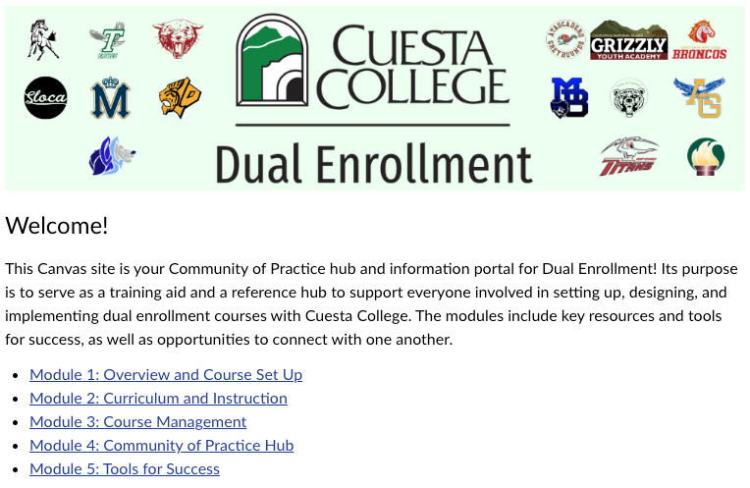
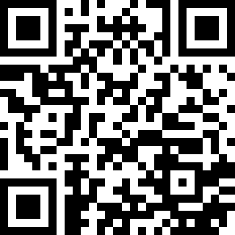
Check Your Cuesta Canvas Dashboard or Scan to Enroll: https://tinyurl.com/cuesta-ccap-canvas
Notes:
https://tinyurl.com/cuesta-ccap-canvas
MEK – guide to discussions and have them work on it with available time

Slide 20
Next Steps for Community of Practice
Canvas Discussions, Tasks, and Announcements.
Next Hybrid Gathering will be held in January 2026.
Arrange a presentation for your Department or Division on dual enrollment opportunities.
Connect with interested high school districts or teachers.
Communicate your willingness to be a faculty designee or teach a Cuesta-led dual enrollment section to your Division Chair.
Notes:
Scheduling begins in Fall for next year.

Slide 21
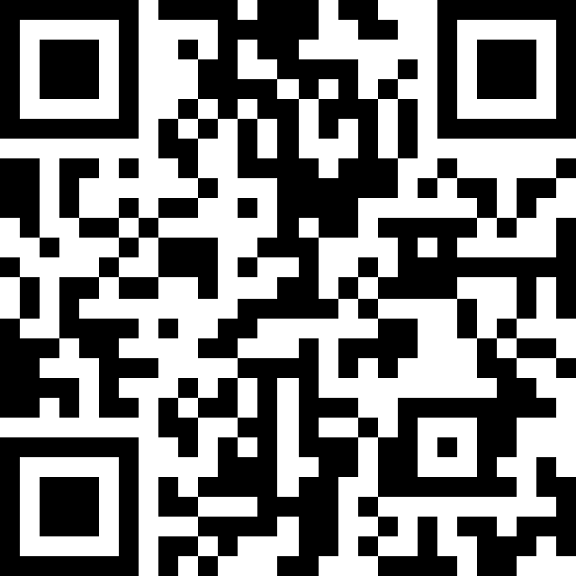
Q&A and Contact Information
Questions?
Please scan here or visit tinyurl.com/ccap-feedback10 to provide additional feedback using an anonymous form:
Gina Barbosa
Program Specialist – Dual Enrollment
805-592-9468 • gina_barbosa@cuesta.edu
Tasha Williams
Program Specialist – Dual Enrollment
805-592-9322 • tasha_williams@cuesta.edu
Kristina Vastine
Associate Director of Instruction – Dual Enrollment/CCAP
805-592-9393 • kristina_vastine@cuesta.edu
Dr. Mario Espinoza-Kulick
Faculty Coordinator – Dual Enrollment/CCAP
805-592-9810 • mario_espinozakulick@cuesta.edu

Slide 22
Appendix

Slide 23
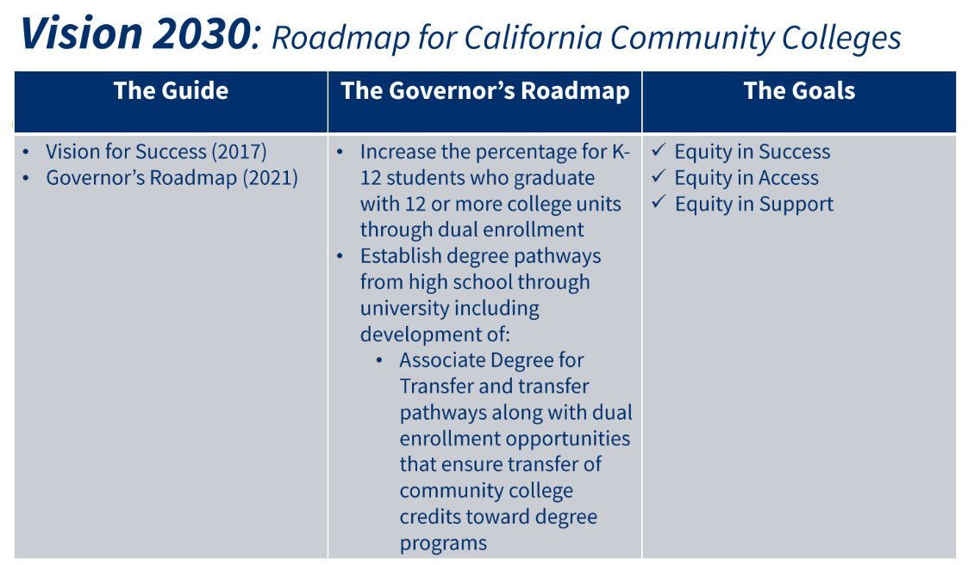
The Power of Dual Enrollment
National Data
State Momentum - Vision 2030
National Data suggests students who participate in college in high school programs are more likely to:
  Graduate High School
  Enroll in College
  Persist in College
  Complete a College Degree or Credential
Notes:
MEK

Slide 24
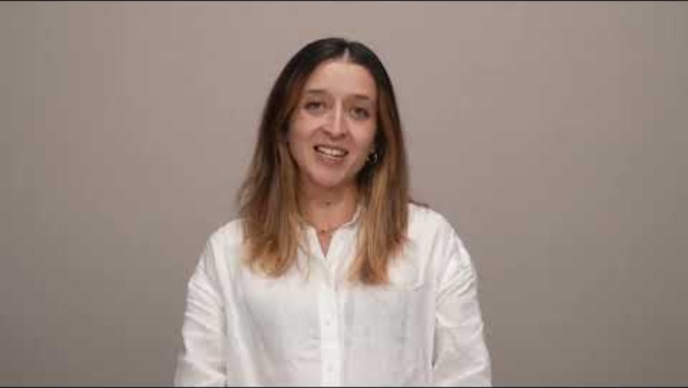
Community College Research Center at Columbia College Data on Dual Enrollment
For more information, read "The Postsecondary Outcomes of High School Dual Enrollment Students: A National and State-by-State Analysis"
Notes:
MEK

Slide 25
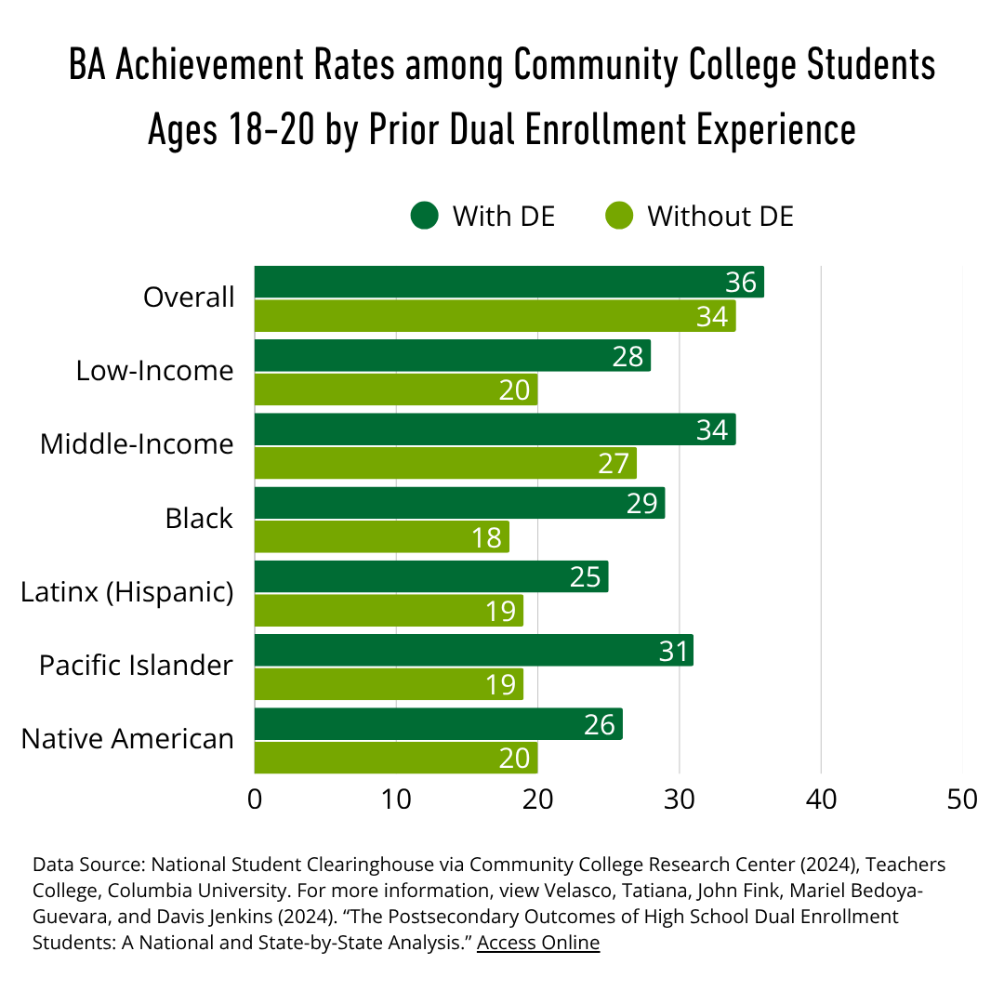
Dual Enrollment Outcomes
Dual enrollment contributes to students' later success in college, including earning a BA degree
Dual enrollment makes a larger difference for historically underrepresented groups:
  Low-income groups show an 8% increase in BA achievement with dual enrollment compared to those without. Similarly:
  Middle-income students show a 7% increase
  Black students show an 11% increase
  Latinx (Hispanic) and Native American students show a 6% increase, each
  Pacific Islander students show a 12% increase
Notes:
MEK
DE benefits under-represented groups by increasing BA and AA earning among Black, Latinx (Hispanic), Native American, Pacific Islander, Low-Income, and Middle-Income groups across the state of California
Acknowledge

Slide 26
Recognize and Build on Student Drive
Example Teacher Action Steps
  Invite students to reflect on what motivates them and who they’re working hard for.
  Use writing prompts or discussions that connect course content to personal values and goals.
Student Outcomes
  Stronger motivation rooted in purpose and personal identity.
  Increased confidence in their ability to succeed in college-level work.
Notes:
MEK
Students have strong internal motivation shaped by family, community, and personal goals. When instructors intentionally acknowledge and build on student motivation, they affirm students’ purpose and help sustain their momentum.

Slide 27
Connect Students to Supportive Adults and Peers
Example Teacher Action Steps
  Introduce students to supportive adults (such as librarians, campus staff, or service providers) and peer leaders in their academic environment.
  Invite college students, alumni, or staff to share stories and advice about navigating higher education.
Student Outcomes
  Greater sense of belonging and confidence in seeking help.
  Expanded support network and awareness of college resources.
Notes:
MEK
Supportive relationships play a key role in academic success, especially for students who may not have existing networks in higher education. Connections to peers, staff, faculty, and institutional agents help students feel seen, supported, and capable of navigating challenges.

Slide 28
Make Curriculum Relevant and Useful
Example Teacher Action Steps
  Choose readings, topics, and assignments that reflect students’ lived experiences.
  Provide opportunities for students to apply course content to real-world challenges.
Student Outcomes
  Increased engagement through personal relevance and cultural connection.
  Stronger sense of agency in using education to address real issues.
Notes:
MEK
Students are more engaged when coursework connects to their lives, cultures, and real-world issues. Culturally responsive curriculum fosters critical thinking, validates student identity, and makes learning more meaningful by showing students how their knowledge can lead to action and change.

Slide 29
Help Students See the Bigger Picture
Example Teacher Action Steps
  Teach about the educational journeys of key figures in your discipline to show the multi-faceted pathways to achievement.
  Incorporate knowledge skills such as checking transcripts, writing emails, or accessing student portals during instruction.
Student Outcomes
  Clearer understanding of their academic pathway and next steps.
  Increased ability to self-advocate and make informed decisions about their education.
Notes:
MEK
Students are still figuring out their college and career pathways. Making the systems visible and teaching key college knowledge helps students see what’s possible , how to plan for it, and how to advocate for themselves and their families in educational settings.

Slide 30
References and Further Reading
Mireles-Rios, Rebeca, Victor Rios, Bertin Solis, and Jose Gutierrez. 2024. “Ganas as a Praxis: Cultural Responsiveness in Latinx/a/o Higher Education Success.” In Studying Latinx/a/o Students in Higher Education: A Critical Analysis of Concepts, Theory, and Methodologies. Access Online
Salazar, Rogelio. 2024. Working Towards an Equitable Future in California Dual Enrollment Programs. Berkeley, CA: UC Berkeley Center for Studies in Higher Education. https://escholarship.org/uc/item/8682z75j
Salazar, Rogelio. 2023. “An Analysis of Statewide College Promise Programs: Towards a Racially Equitable Future.” New Directions for Community Colleges 2023(201):111–127. https://doi.org/10.1002/cc.20591
Stanton-Salazar, Ricardo D. 2001. Manufacturing Hope and Despair: The School and Kin Support Networks of U.S.-Mexican Youth. New York: Teachers College Press. Access Online
Yosso, Tara J. 2005. “Whose Culture Has Capital? A Critical Race Theory Discussion of Community Cultural Wealth.” Race Ethnicity and Education 8(1):69–91. https://doi.org/10.1080/1361332052000341006

Slide 31
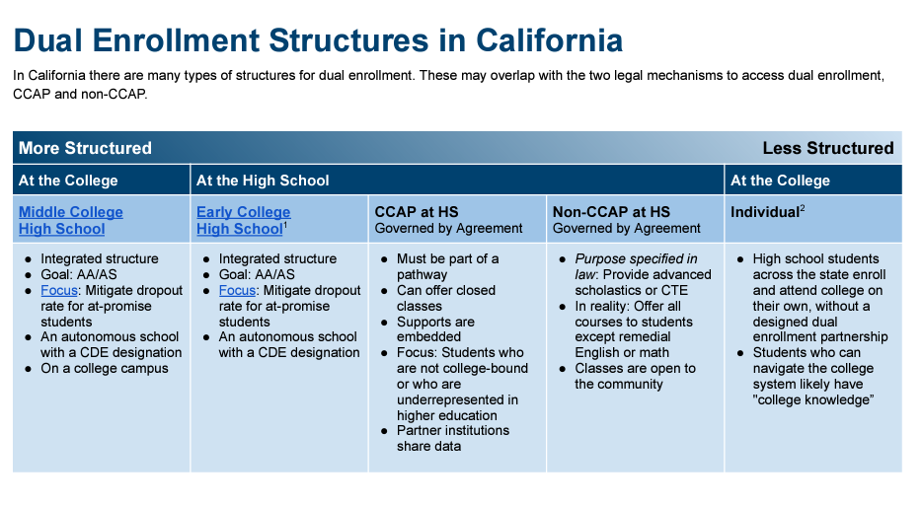

Slide 32


Slide 33
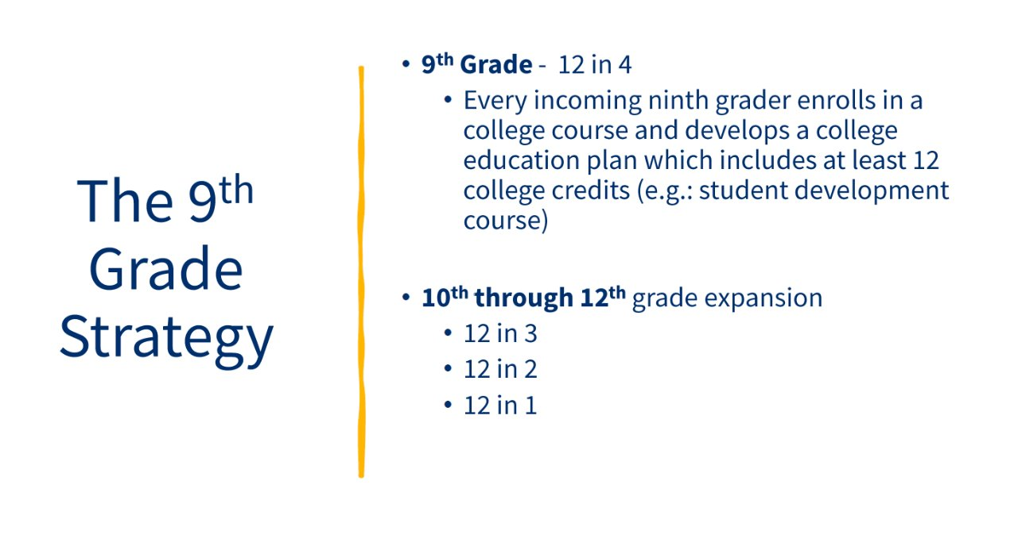

Slide 34
Enrichment Program Overview
Students participate in Cuesta College classes outside of their high school timeframes*
Enrollment Fees waived
  Health Fee, Parking, Student ID, Textbooks, and Instructional Materials fees are not exempt.
Courses are a part of a particular pathway:
  Advanced Scholastic coursework
  Vocational coursework
*Exemption: Mission College Prep
Notes:
KV

Slide 35
College and Career Access Pathways
The provisions of AB 288, AB 30, and SB 1244 (College and Career Access Pathways) include increasing dual enrollment offerings for students who have been historically underrepresented in higher education, focusing on increasing high school graduation rates, and preparation for success in careers and college.
Helps high school students visualize and initiate a career and education pathway.
Decreases costs to community, families and students.
Enhances partnerships between K-12 and Community College Districts.
Notes:
MEK
SB 1244 – works with colleges outside of their service area

Slide 36
College and Career Access Pathways
Cuesta College Collaborators
High School Collaborators
Dual Enrollment Office ​
  Kristina Vastine– Associate Director of Instruction; Dual Enrollment/CCAP​
  Tasha Williams– Program Specialist
  Gina Barbosa – Program Specialist
  Dr. Mario Espinoza-Kulick – CCAP Faculty Coordinator
Admissions and Registration
  Vice President of Student Success and Support Programs
  Aaron Borgeson - Director of Outreach & Enrollment Services​
  Enrollment Success Specialists​
Division Chairs
Content Faculty (Faculty Designees)​
Office of Instruction​
  Instructional Specialists​
  Secretary III – Mylea Christensen
  Clerical Assistant III – Natalie BLANK
Dual Enrollment Coordinator​
  Should be included on all site approvals/decision making​
High School Teachers
Counselors​
Principals/Administration

Slide 37
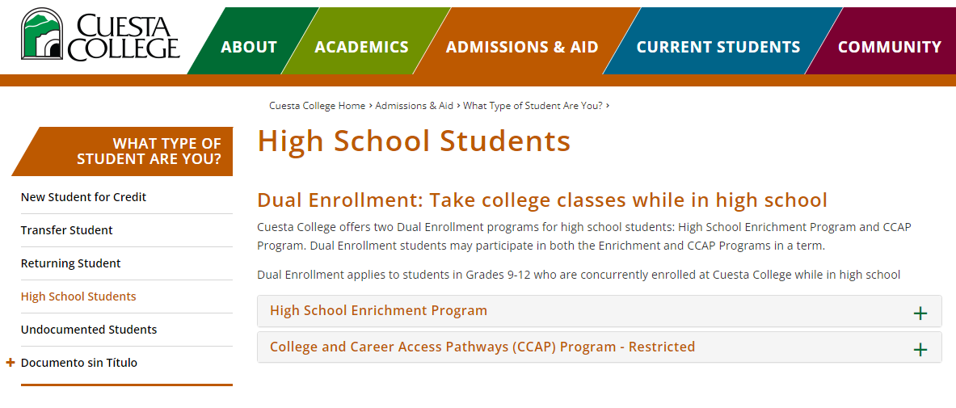
Dual Enrollment at Cuesta College
Dual Enrollment Students are capped at 11 units Fall/Spring; 9 Summer

Slide 38
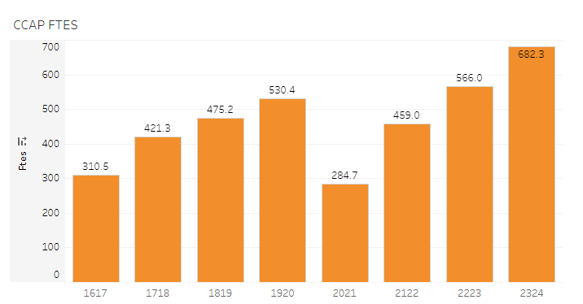
CCAP Program: 2023-2024 Academic Year
317 Cuesta College sections
  Roughly 15% in Cuesta Led Model
60 Unique Courses
  CTE; Transfer Prep; College and Career Readiness
3,847 Unduplicated students; 5,515 enrollments
89 High School Teachers
19 Cuesta Faculty Utilizing Load for CCAP
34 Faculty Serving as Faculty Designees

Slide 39
CCAP Enrollment Overview
Academic Year | Sections | Headcount | Enrollments | Success
Academic Year 2016 - 2017 | 147 | 1637 | 2869 | 87.8%
Academic Year 2017 - 2018 | 199 | 2240 | 3708 | 87.0%
Academic Year 2018 - 2019 | 226 | 2429 | 4005 | 87.4%
Academic Year 2019 - 2020 | 250 | 2665 | 4323 | 91.7%
Academic Year 2020 - 2021 | 193 | 1350 | 2257 | 89.7%
Academic Year 2021 - 2022 | 250 | 2027 | 3604 | 89.1%
Academic Year 2022 - 2023 | 276 | 2520 | 4392 | 92.4%
TOTAL | 1541 | 14868 | 25158 | 89.4%

Slide 40
CCAP Schedule Development
HS Teacher Led
Cuesta Led
Driven by High School District through submitting a Course Request List (Fall; Spring; Yr Round)
Curriculum Review Process; Minimum Qualification Review with Faculty Designee
Annual Course Evaluation with Faculty Designee
Driven by High School District through submitting a Course Request List (Fall; Spring; Yr Round)
Course Collaboration Meetings established between Cuesta Faculty and HS Teacher to ensure success
Division Chair works closely with faculty on faculty assignment
*Potential for growth with Cuesta's proactive faculty and staff engagement

Slide 41
2025-2026 CCAP Scheduling Timeline
Deadline | Task | Role Responsible
Friday, 10/25 | Submit Summer Innovation Course Requests | Dual Enrollment Coordinators
Friday, 10/25 | Submit Cuesta Led Priority/Placeholding Course Request for Fall 24/Spring 25 | Dual Enrollment Coordinators
Friday, 1/24 | Submit HS Teacher Led and Priority #2 Cuesta Led Course Requests | Dual Enrollment Coordinators
Friday, 4/11 | Returning Course Annual Evaluation Paperwork Due; New Curriculum Reviews Finalized | Faculty Designees
Mid-May | Finalize Next Academic Year Course List for Cuesta College and HS District BOT Meetings | Dual Enrollment Office

Slide 42
WHY Dual Enrollment?
Dual Enrollment vs AP
Opportunity to Access College and College Resources
Higher Success Rates
  AP History – 64% vs. 95%
  AP Physics – 46% vs. 85%
  AP Env. Sci. – 54% vs. 94%
  AP Psych – 61%
  AP Calc – 64%
  AP English Lang. Comp – 54%
  More scores (https://apstudents.collegeboard.org/about-ap-scores/score-distributions)
Articulation vs. Elective Credit
Counseling
Educational pathway planning through myCuesta Pathway
Embedded Tutoring
Library and Success Center Resources
Basic Needs Resources

